Slide 1
Special Lecture on Web Application Development
PRESENTED BY
ASHOK KUMAR.S
ASSISTANT PROFESSOR/CSE
MIT

Slide 2
Software's Needed to Build Website
XAMPP and WordPress
X- Cross Platform (Windows, Linux and Mac)
A- Apache
M-MySql
P- PHP
P- Perl
To Download XAMPP:
https://www.apachefriends.org/index.html
To Download WordPress:
https://wordpress.org/download/

Slide 3
Install Xampp and Create Database
Install Xampp
Start Apache and Mysql in Xampp control panel
To Create Database:
http://localhost/phpmyadmin
Databases→ Create Database→ Create
To Install WordPress:
Inside Xampp→ htdocs→ Paste downloaded word press file (Rename if you want).

Slide 4
How to work on WordPress
Type the below url in browser
http://localhost/wordpress
Details needed:
Database Name
Username
Password
Host Name
Prefix
Enter all the above details →ok→ Run to install

Slide 5
How to work on WordPress
Provide Sitename and Username →Ok (Password is Auto Generated) .
Copy the auto Generated Password to login.
Login To create Website:
http://localhost/wordpress/wp-admin
Login with username and password.

Slide 6
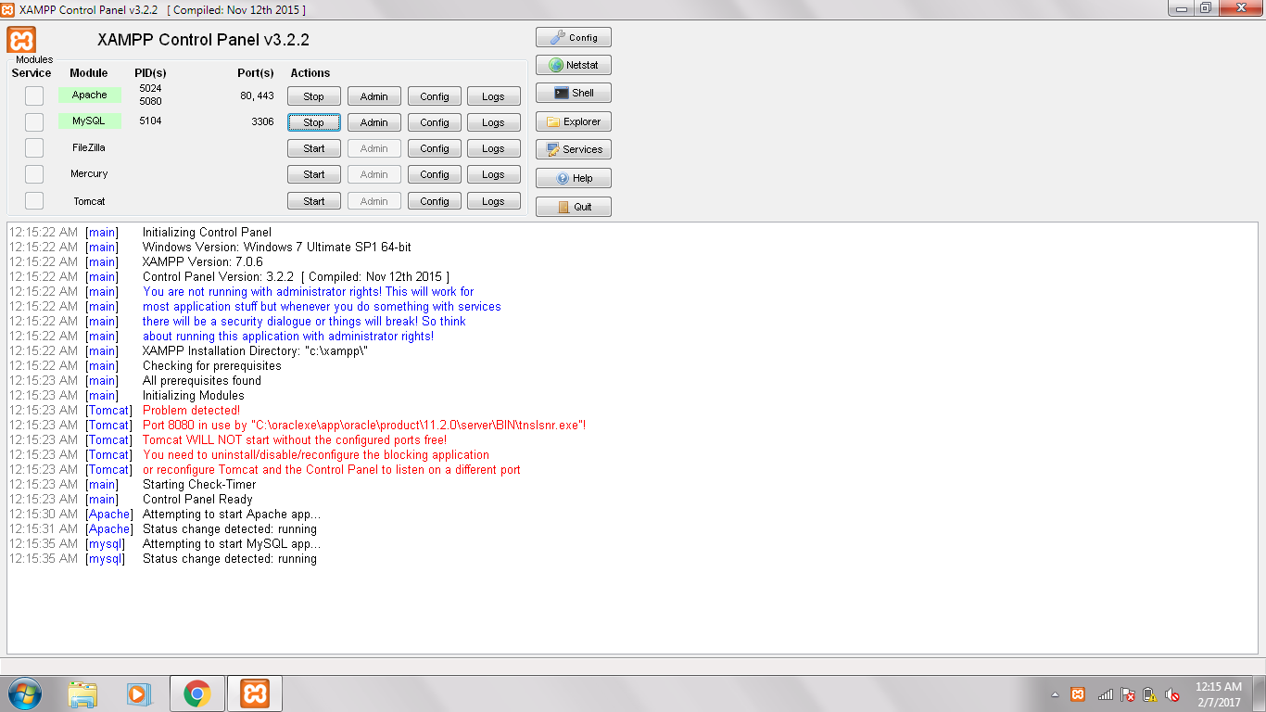

Slide 7
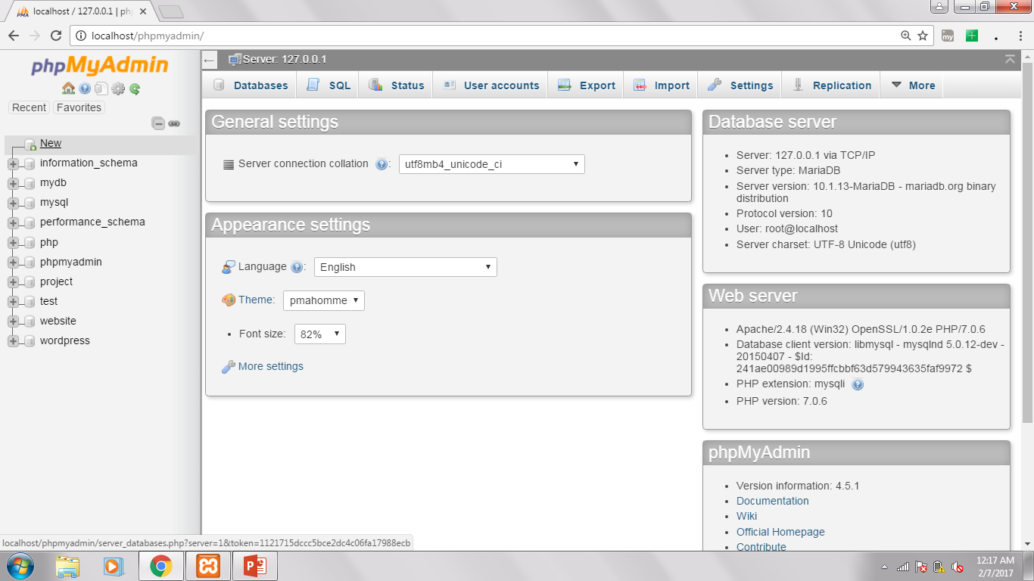

Slide 8
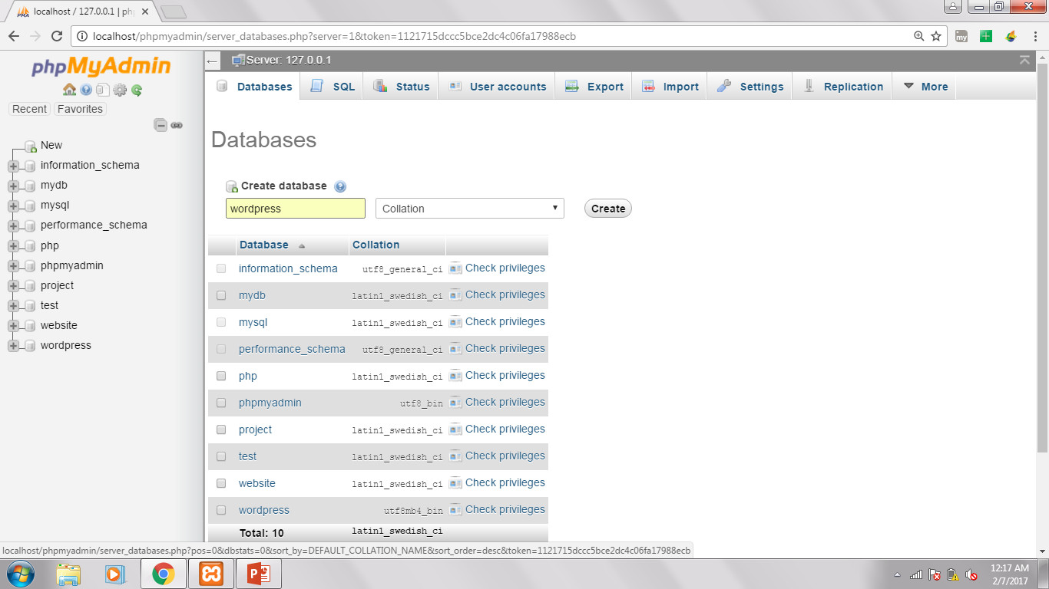

Slide 9
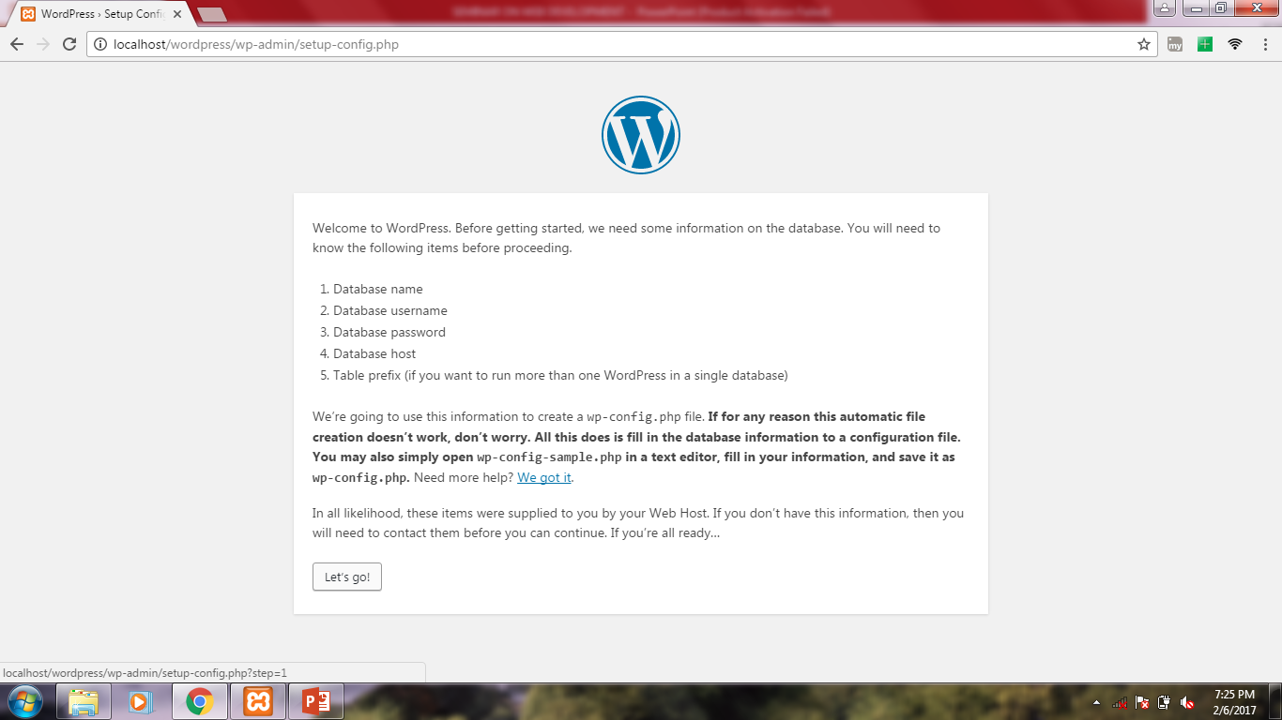

Slide 10
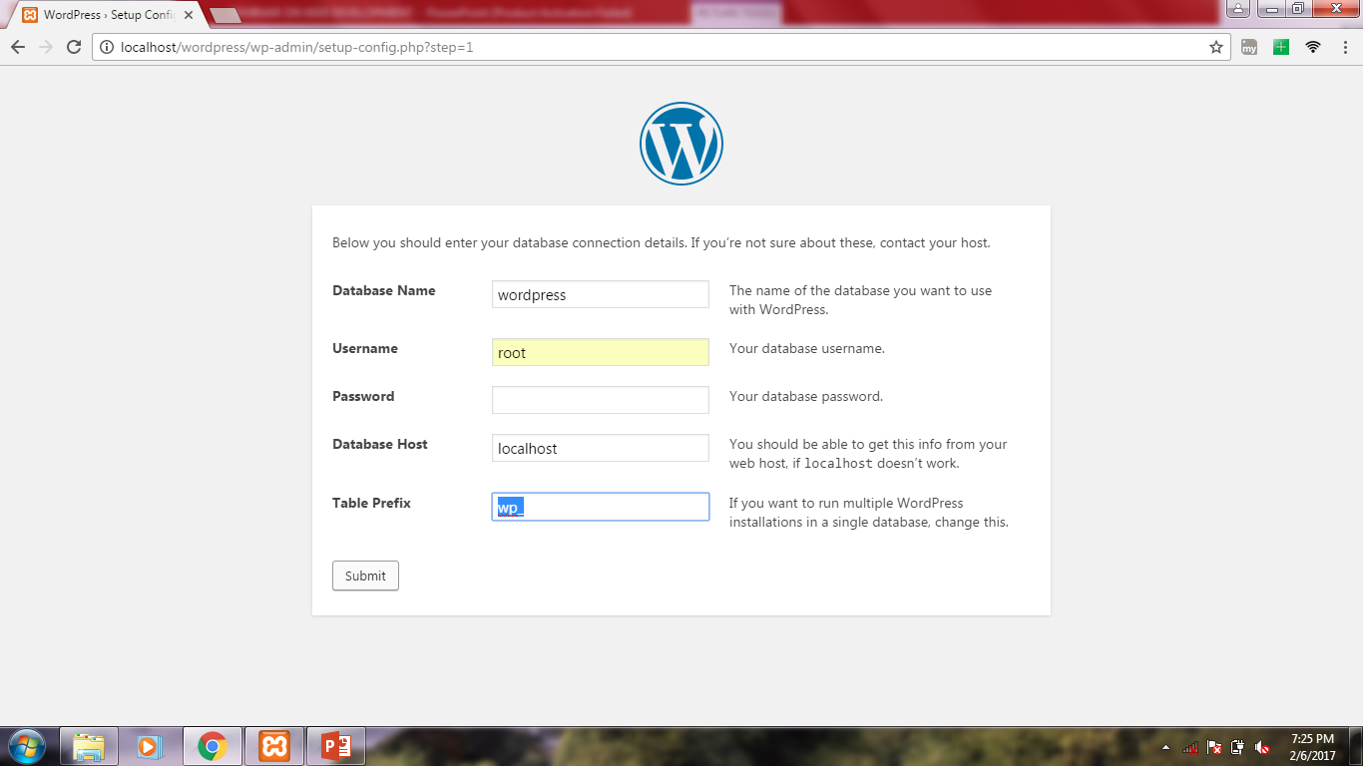

Slide 11
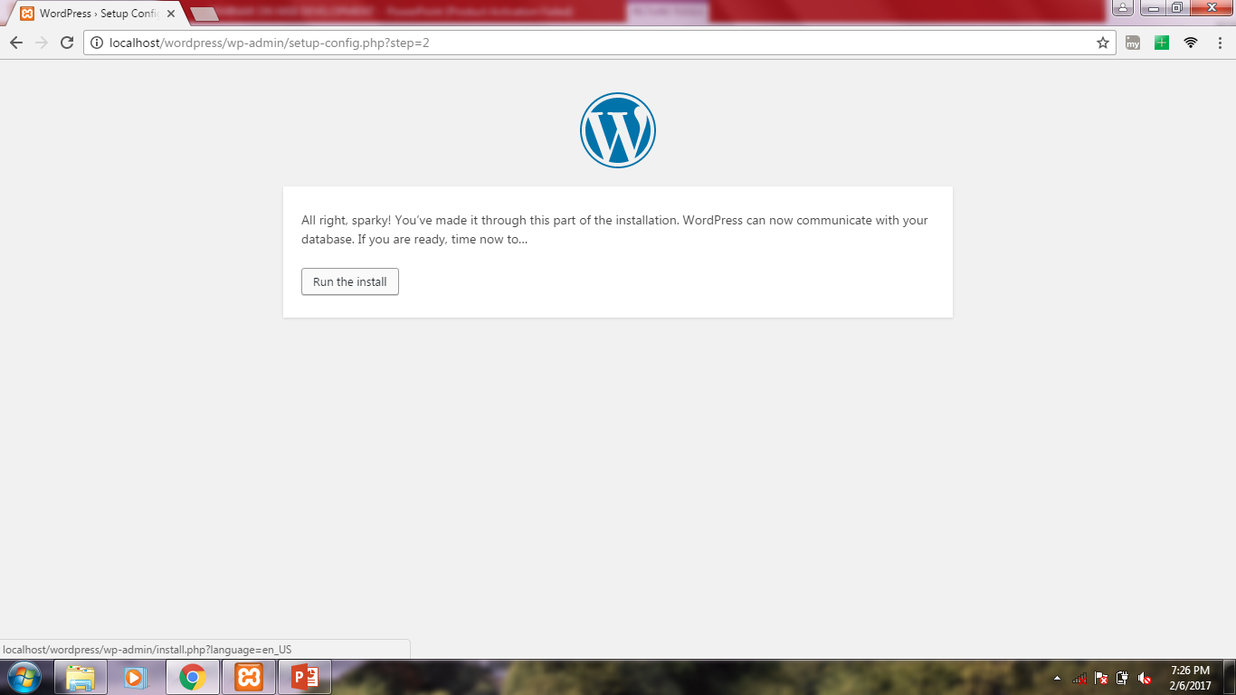

Slide 12
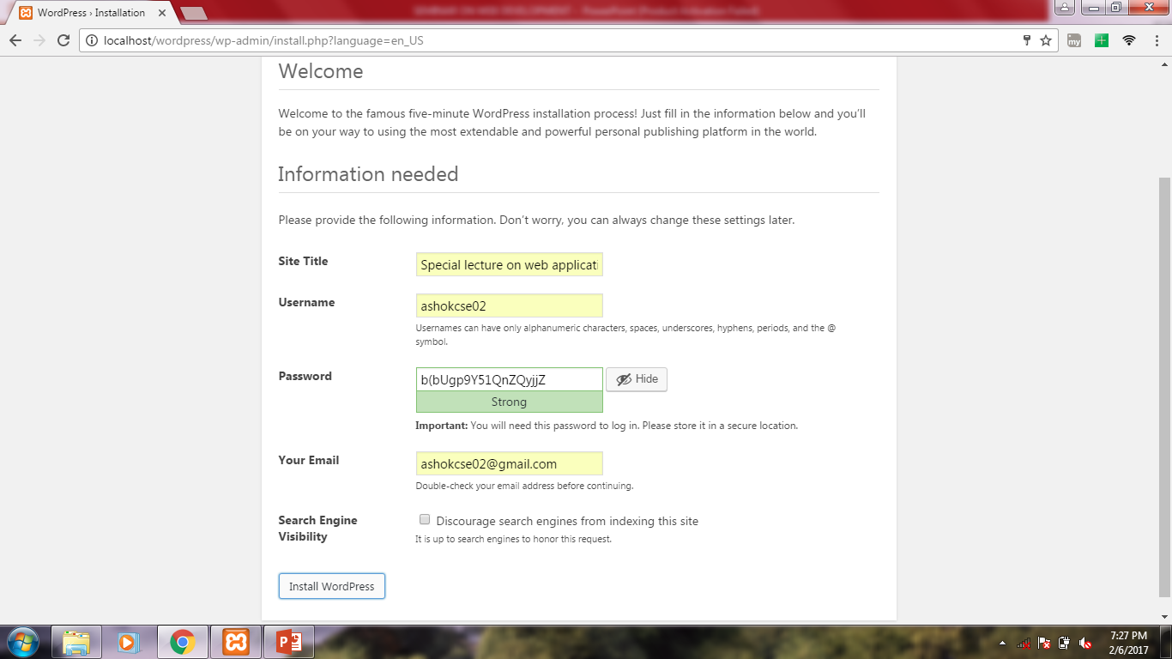

Slide 13
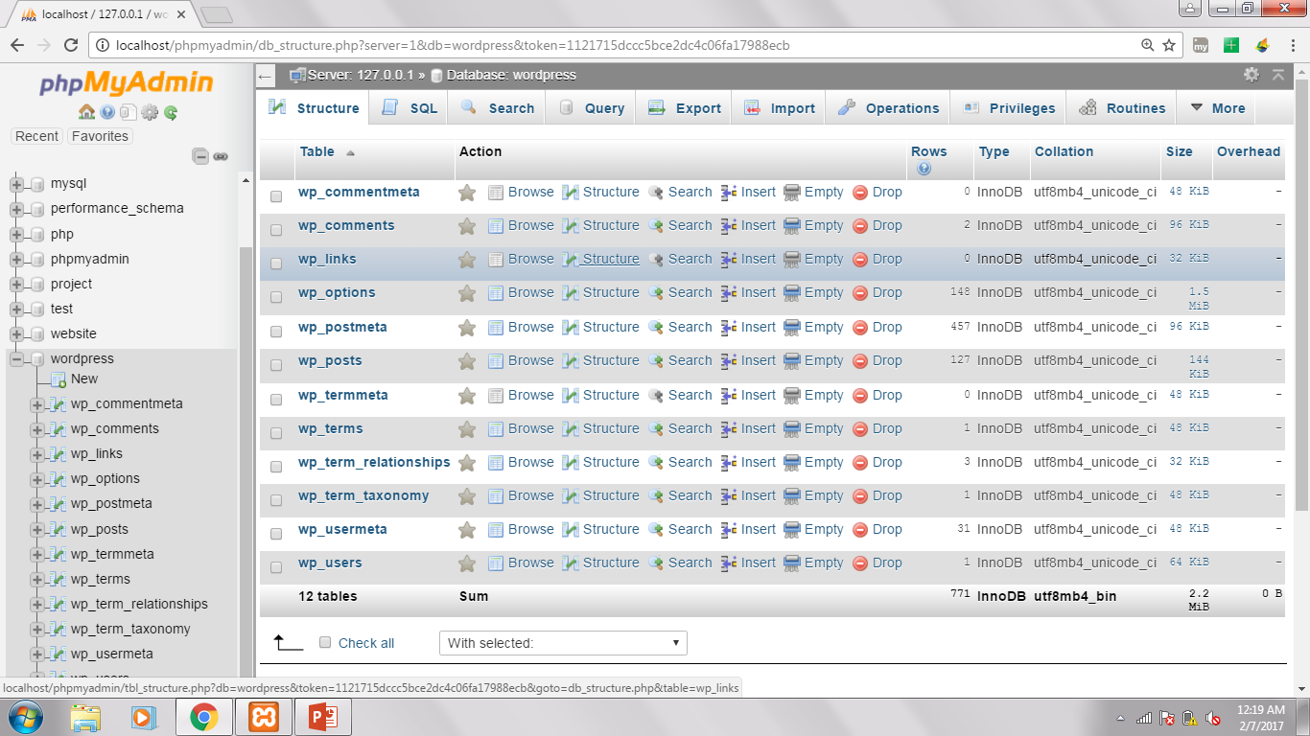

Slide 14
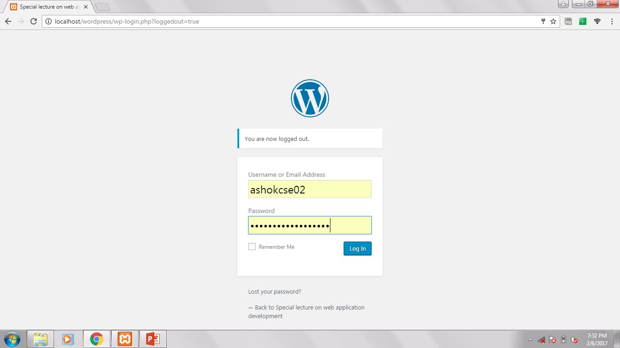

Slide 15
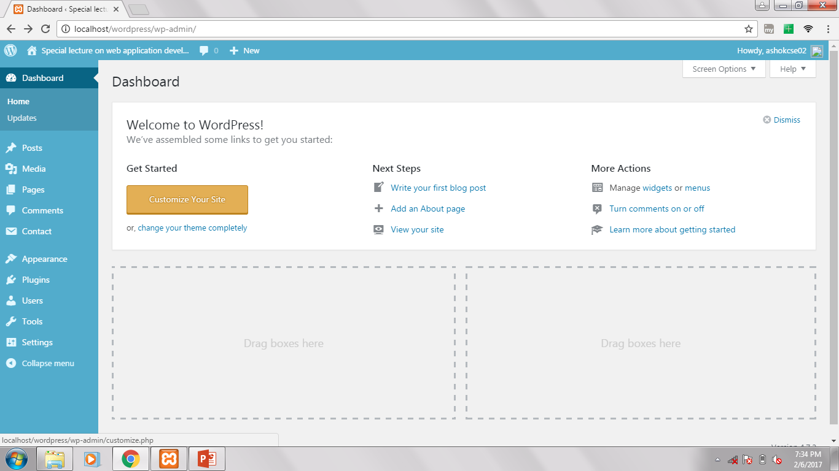

Slide 16
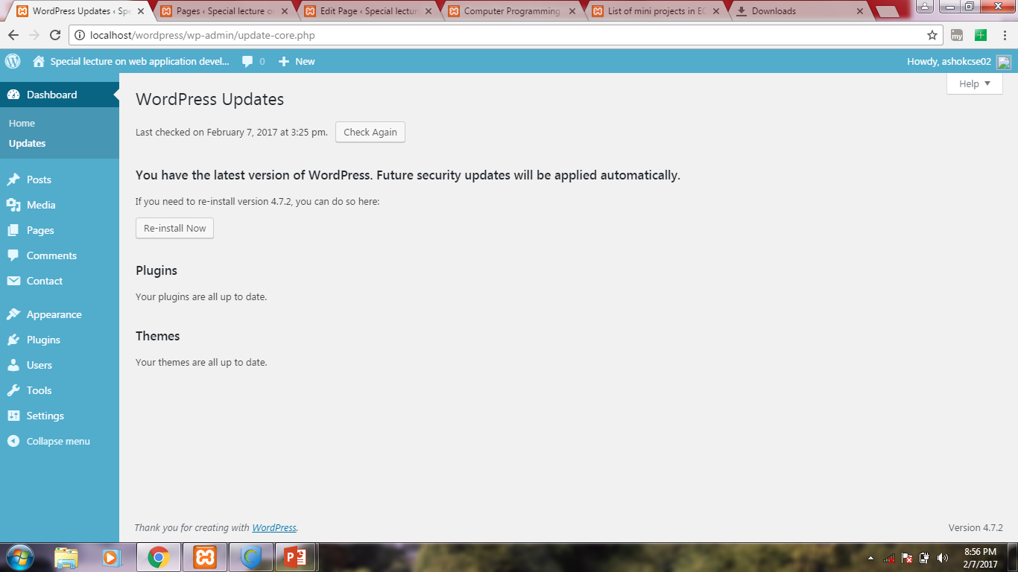

Slide 17
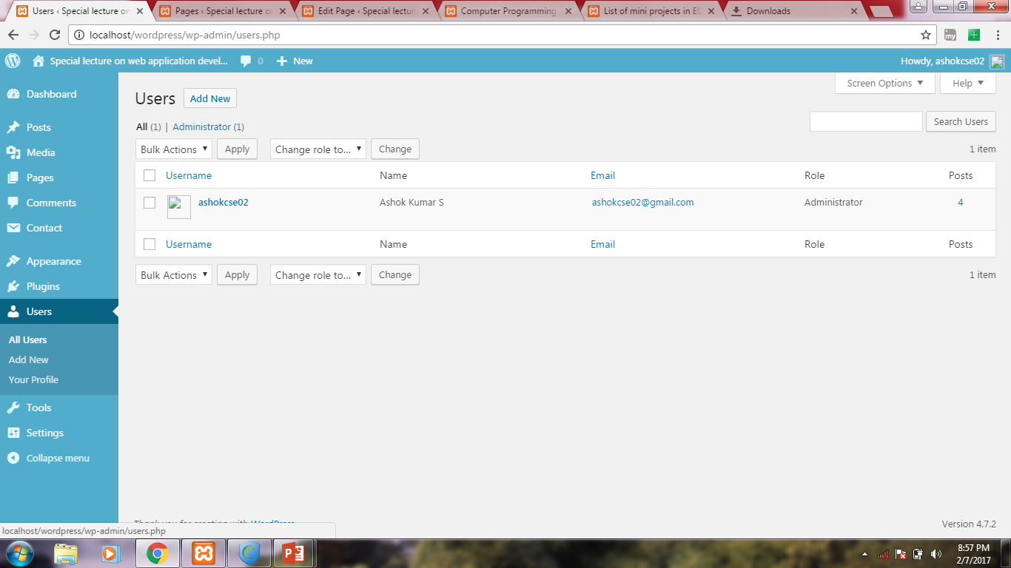

Slide 18
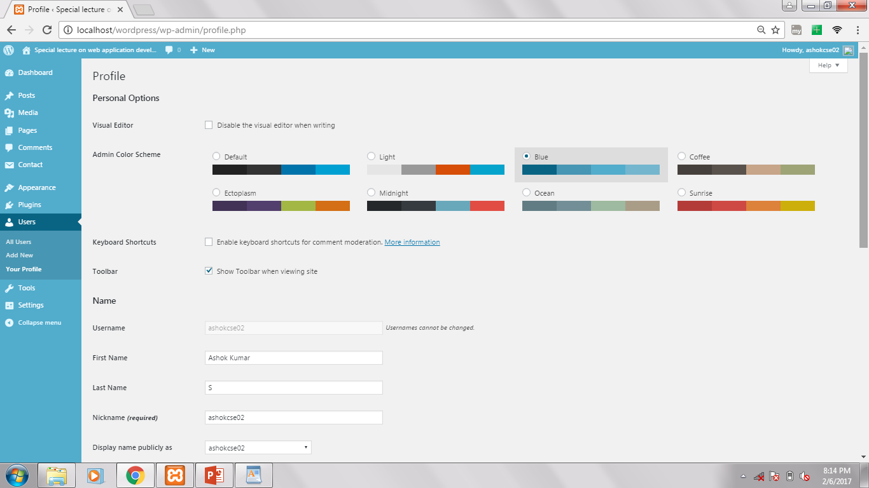

Slide 19
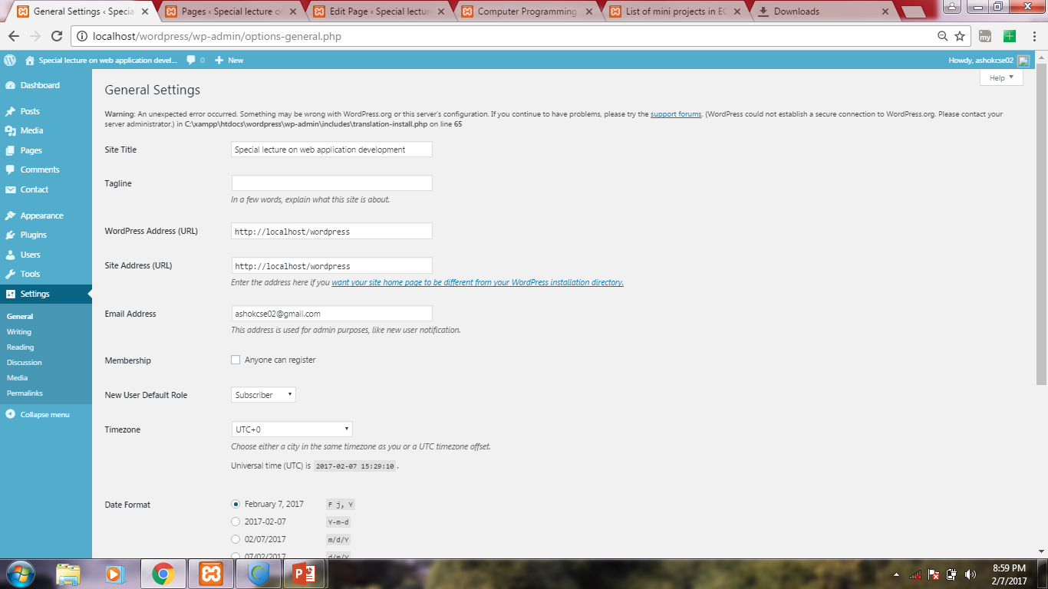

Slide 20
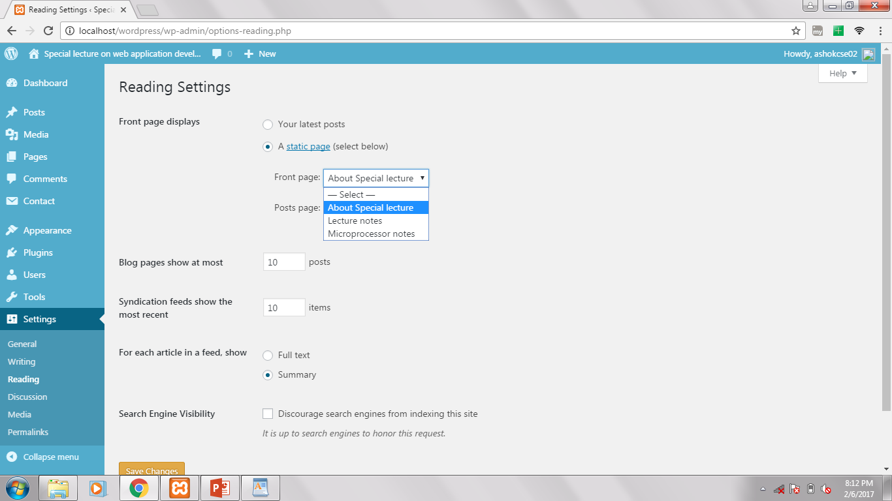

Slide 21
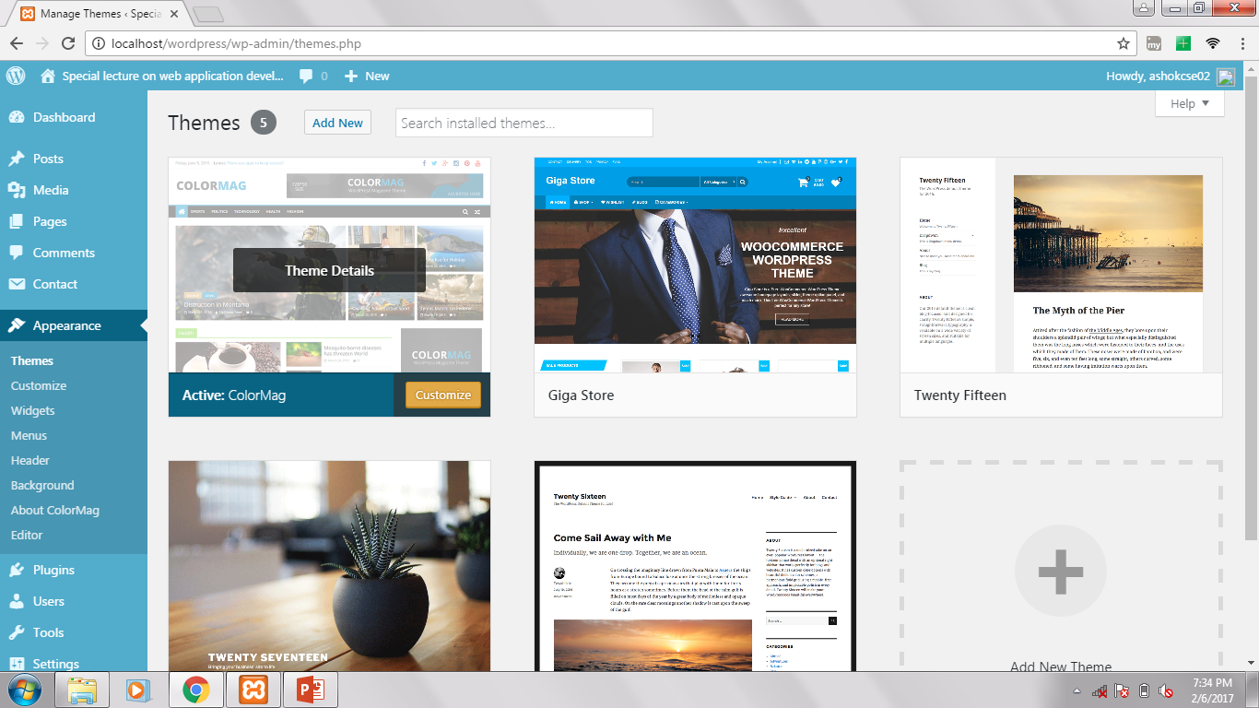

Slide 22
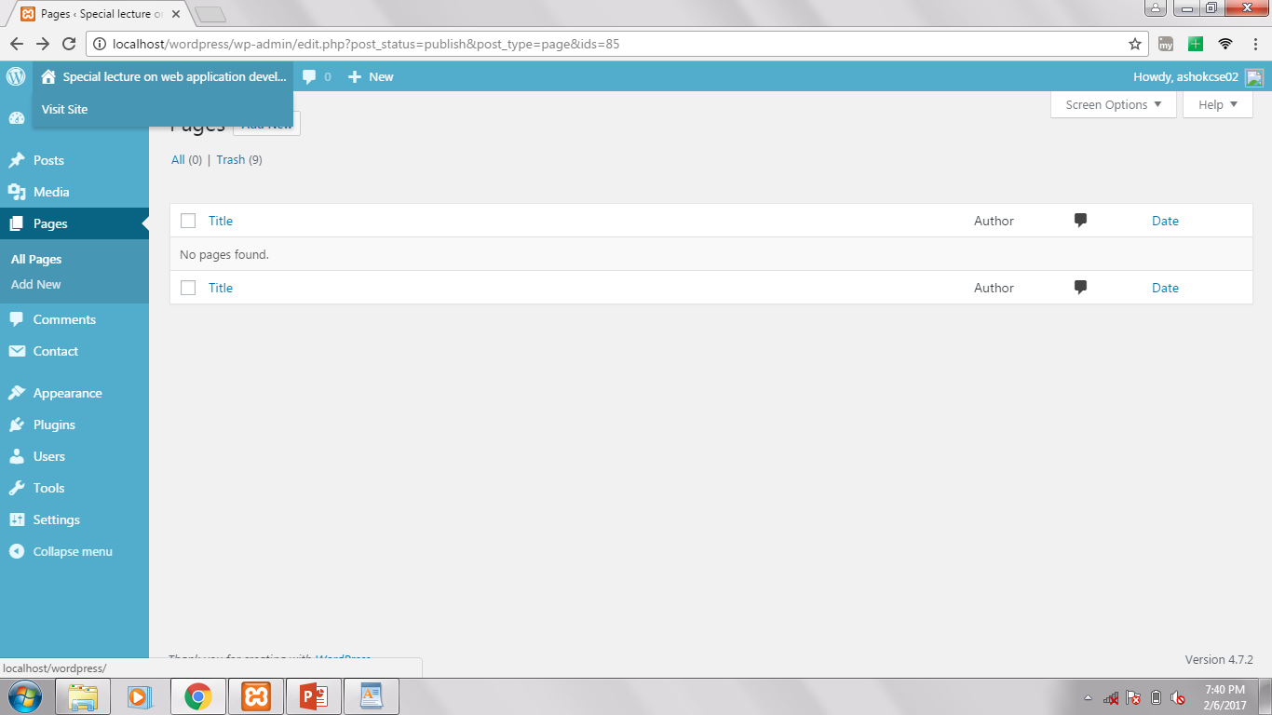

Slide 23
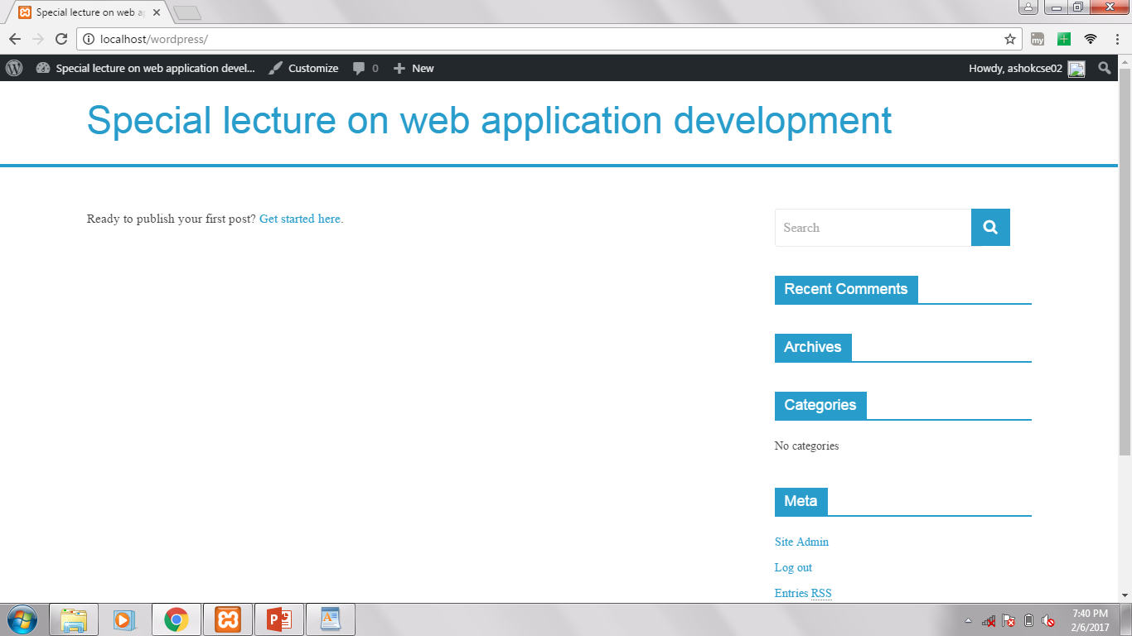

Slide 24
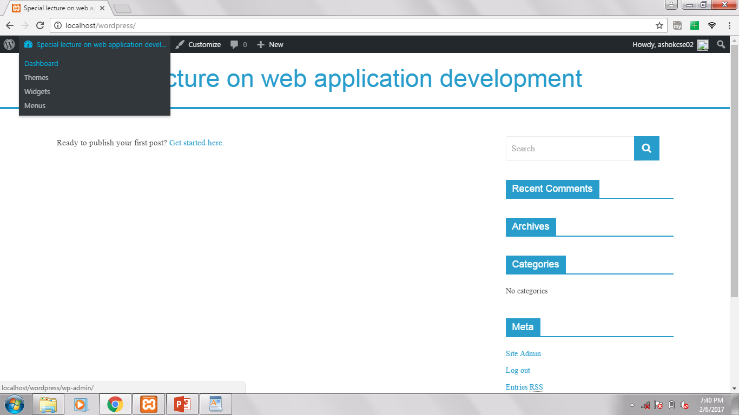

Slide 25


Slide 26
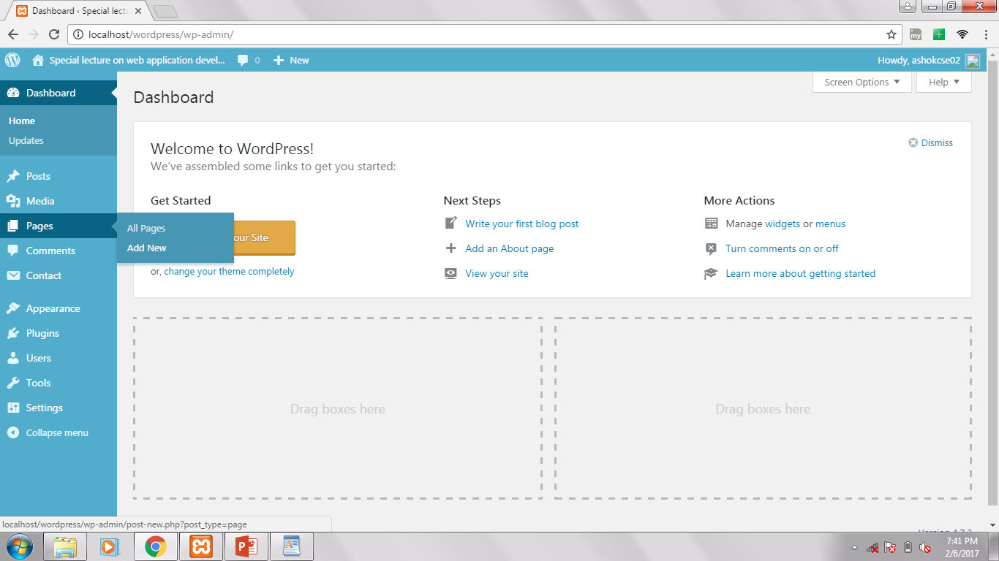

Slide 27
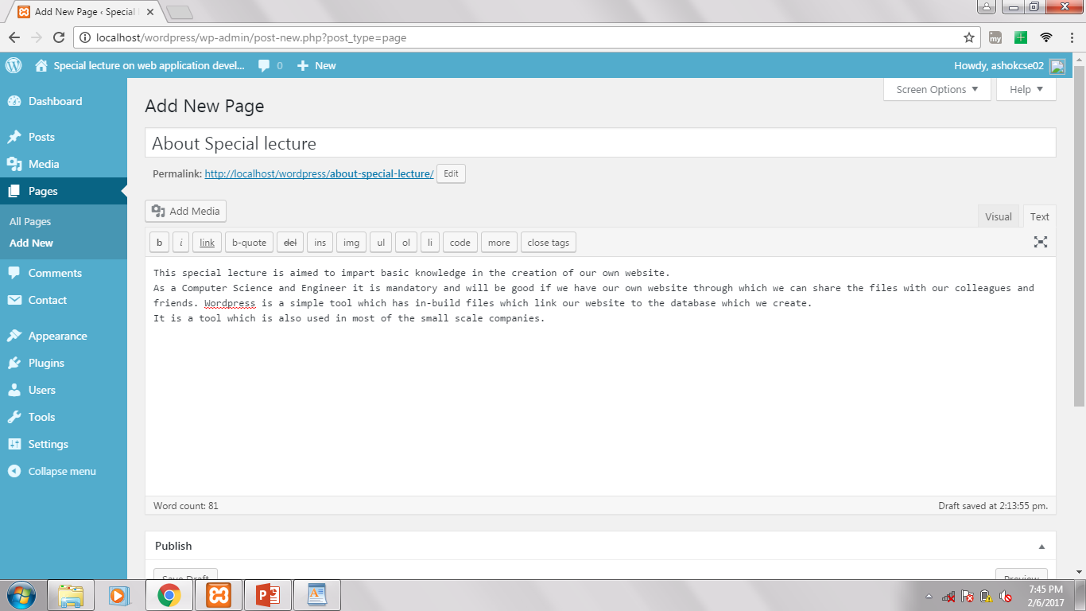

Slide 28
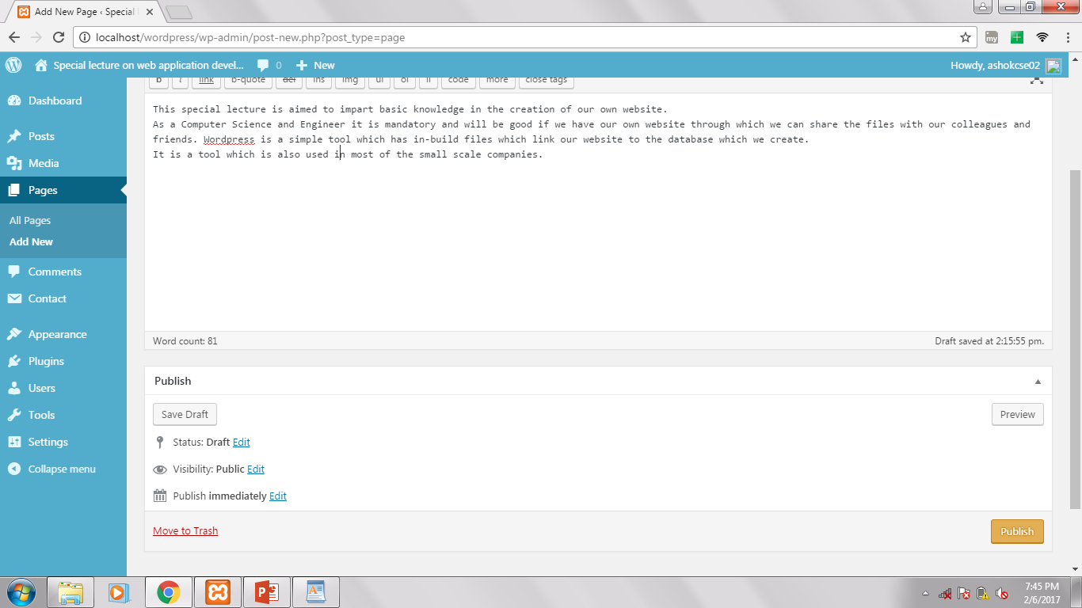

Slide 29
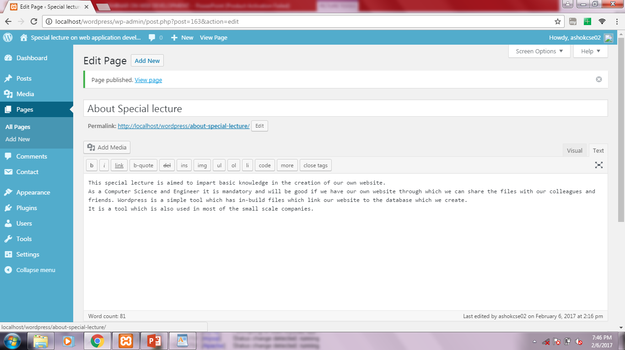

Slide 30
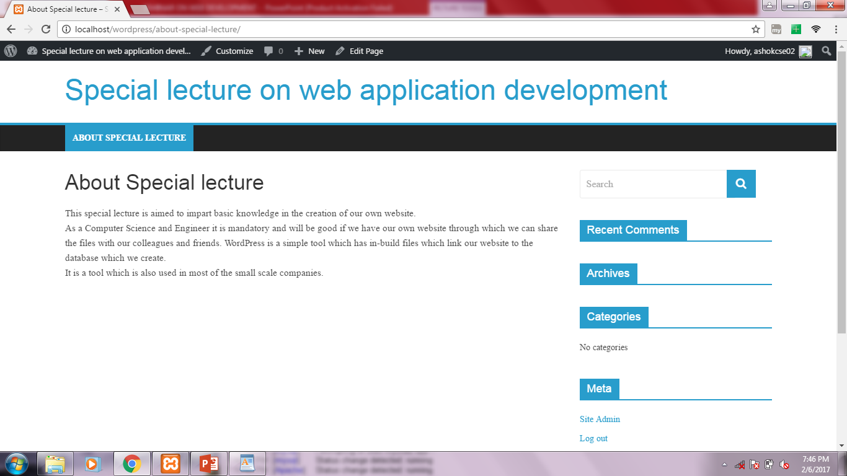

Slide 31
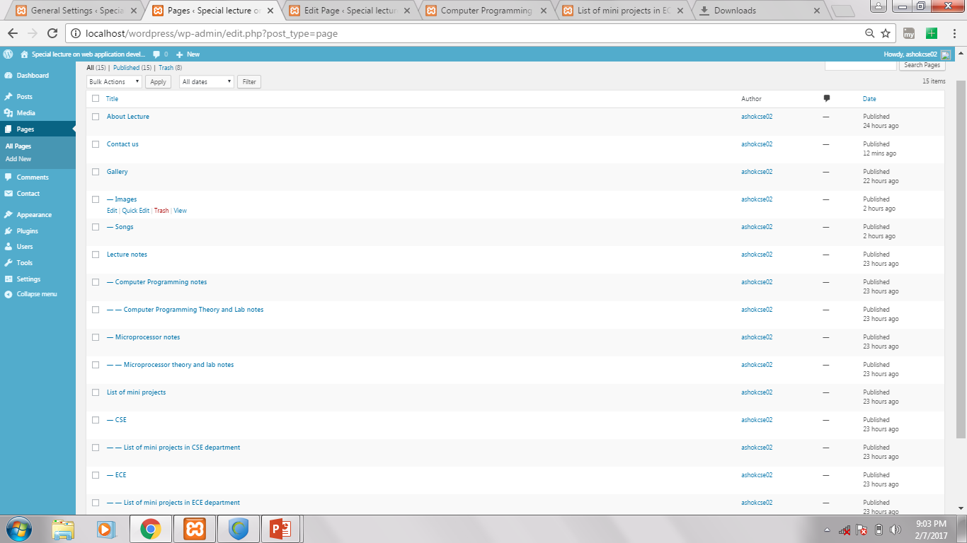

Slide 32
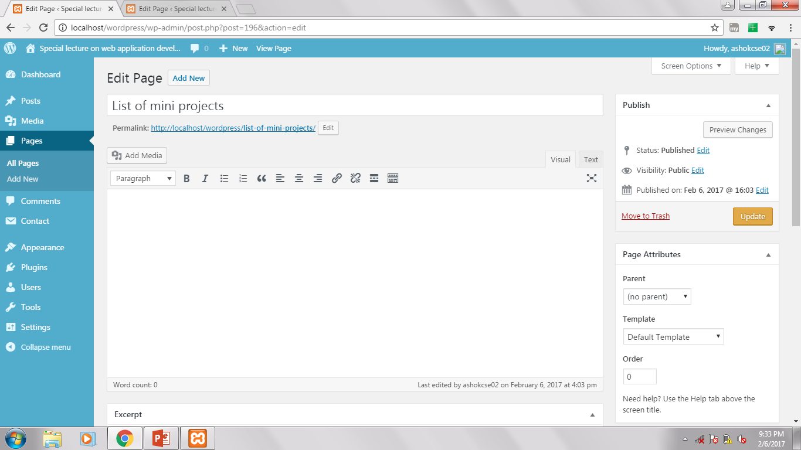

Slide 33
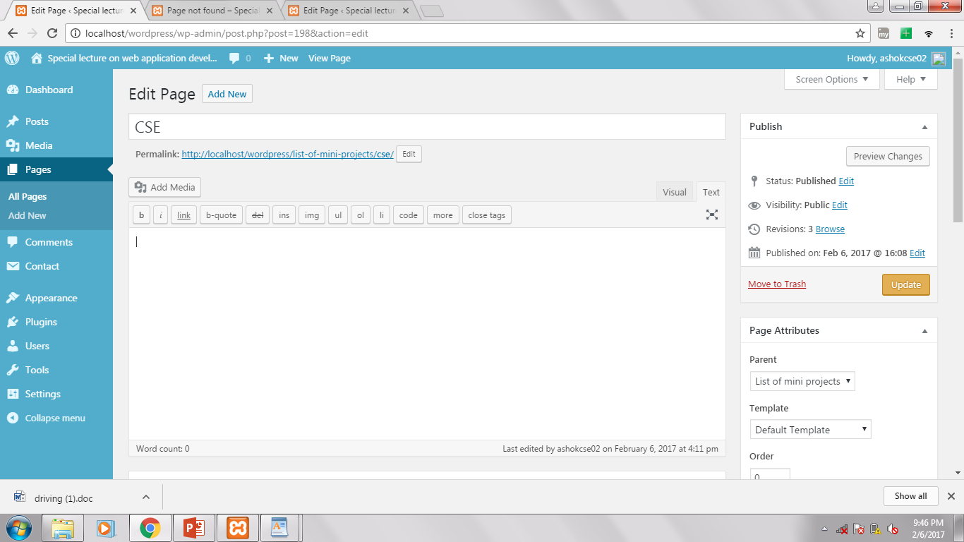

Slide 34
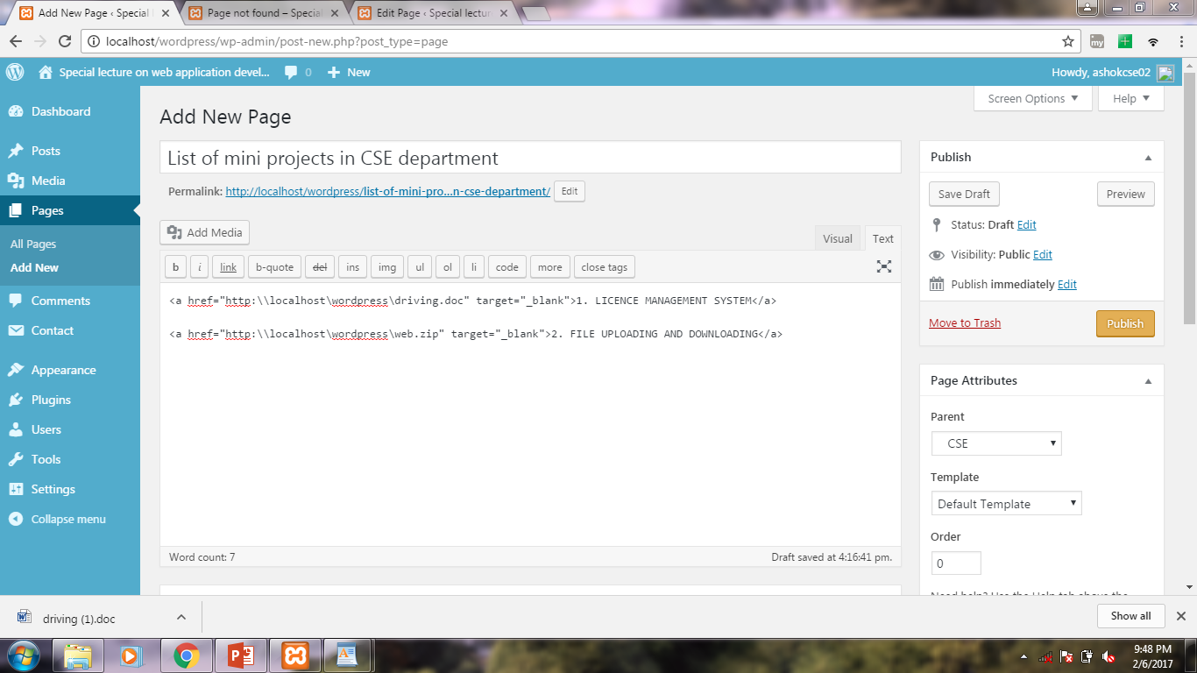

Slide 35
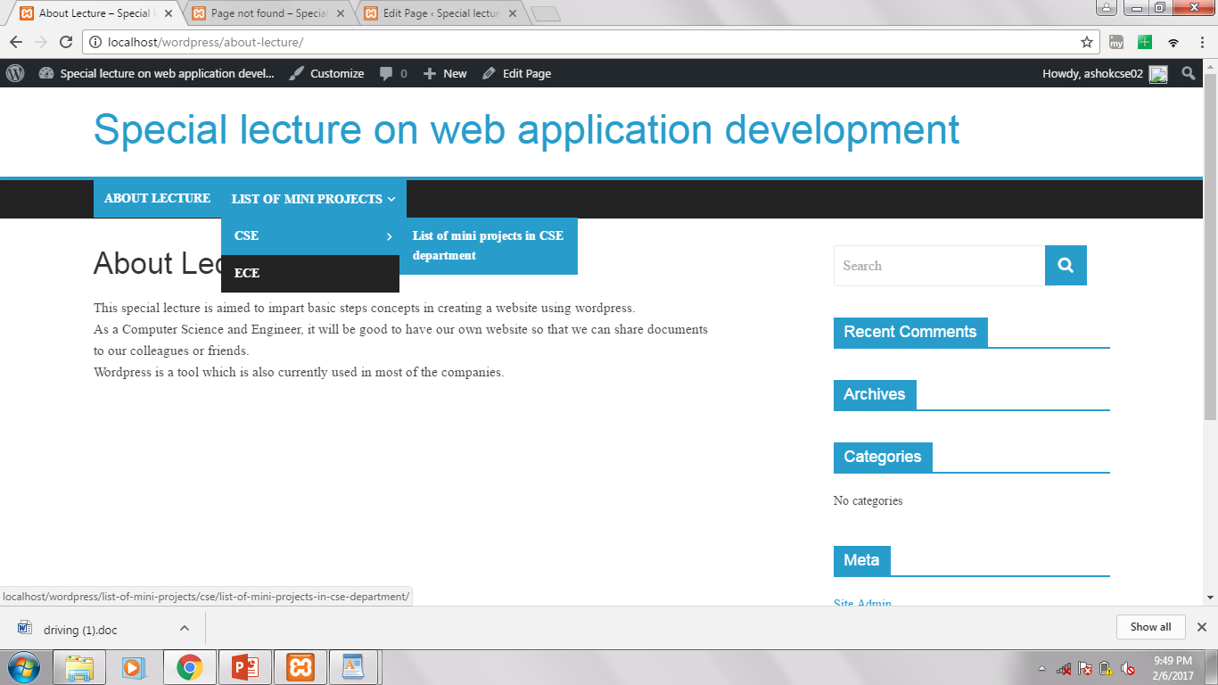

Slide 36
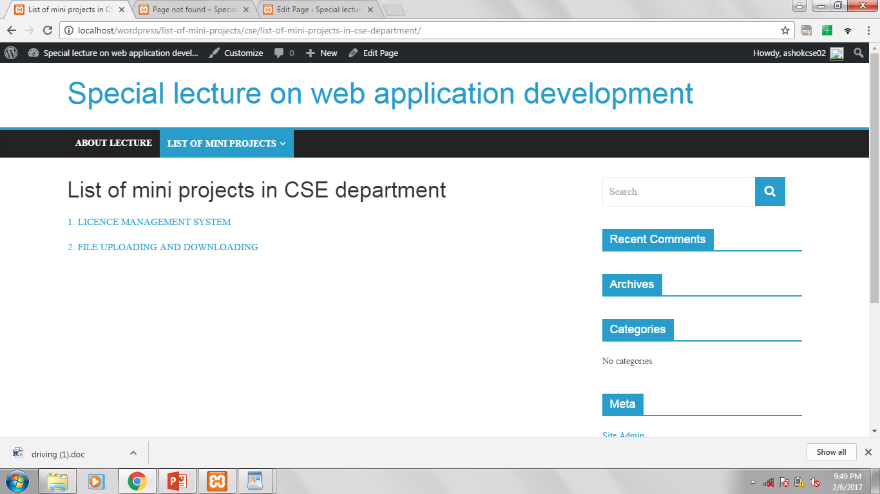

Slide 37
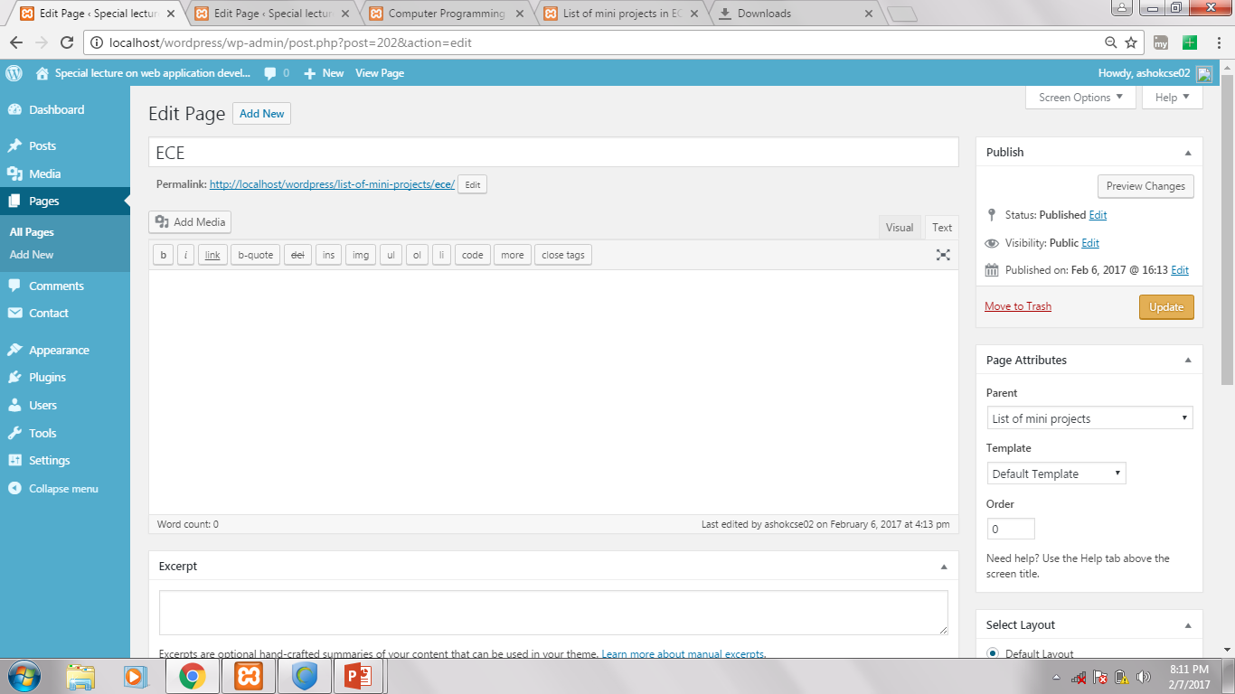

Slide 38
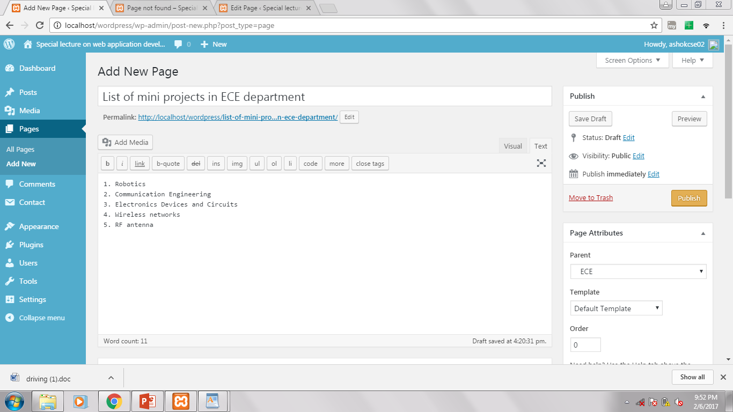

Slide 39
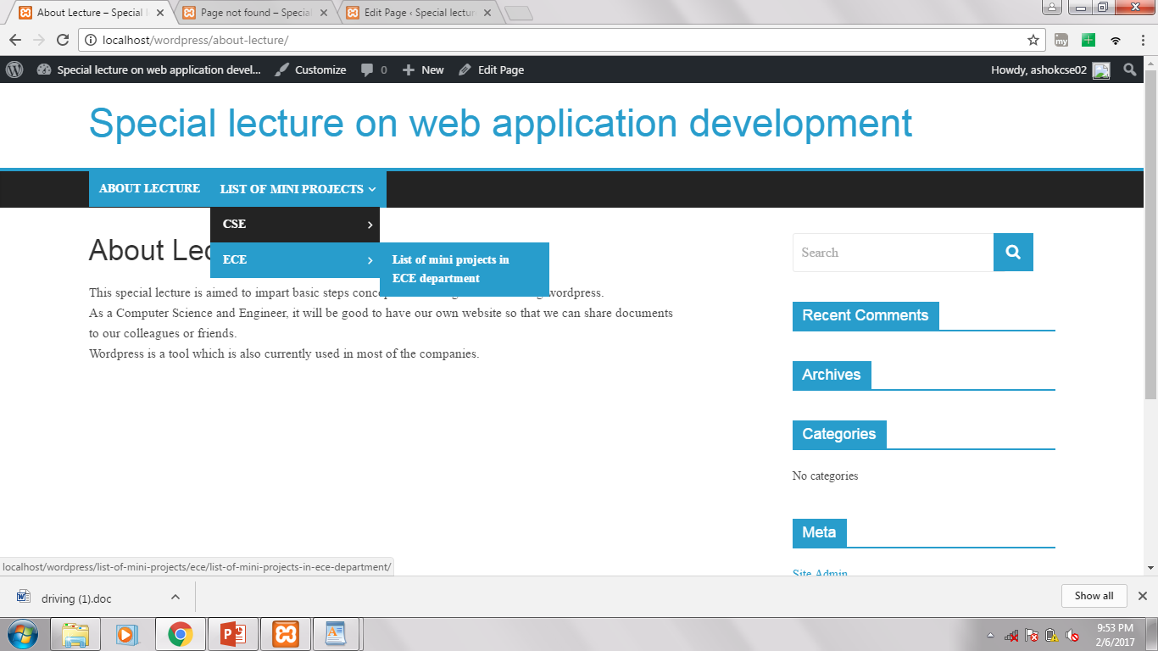

Slide 40
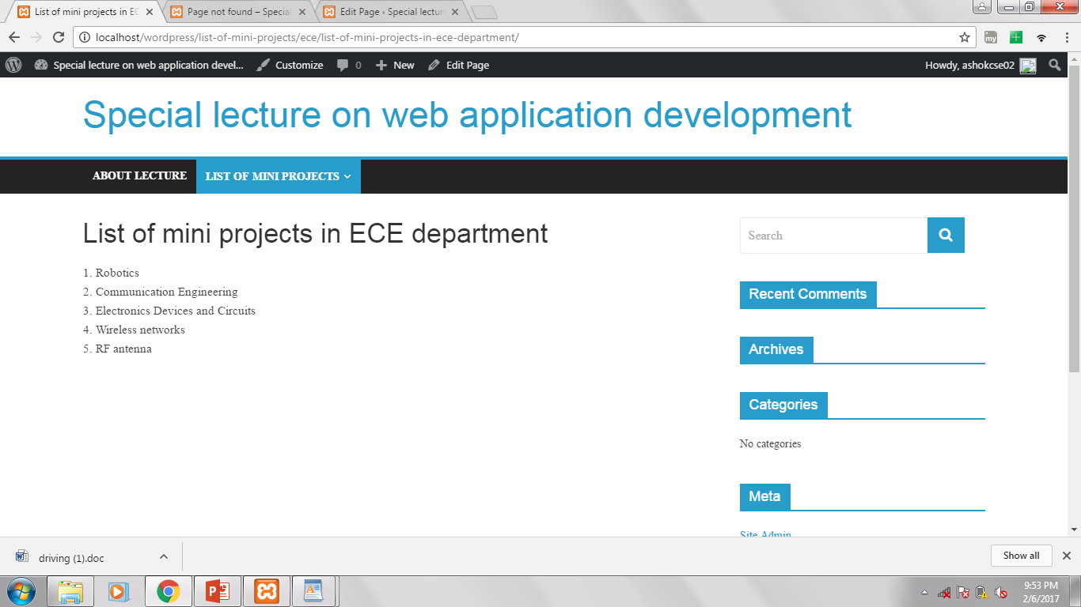

Slide 41
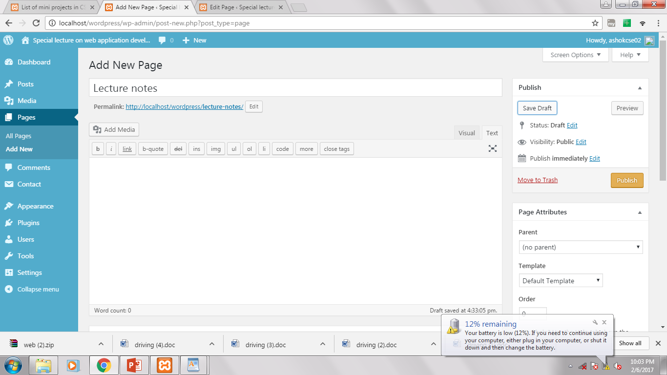

Slide 42
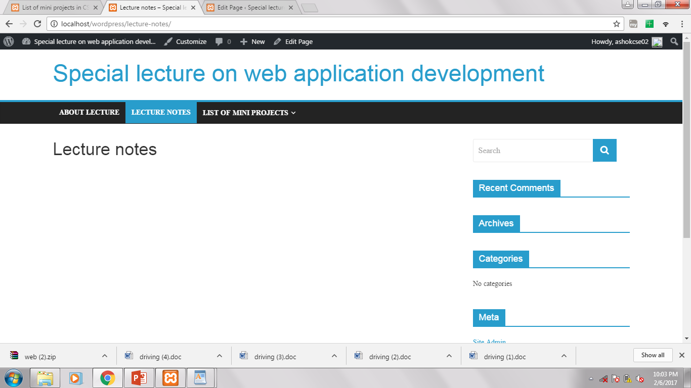

Slide 43
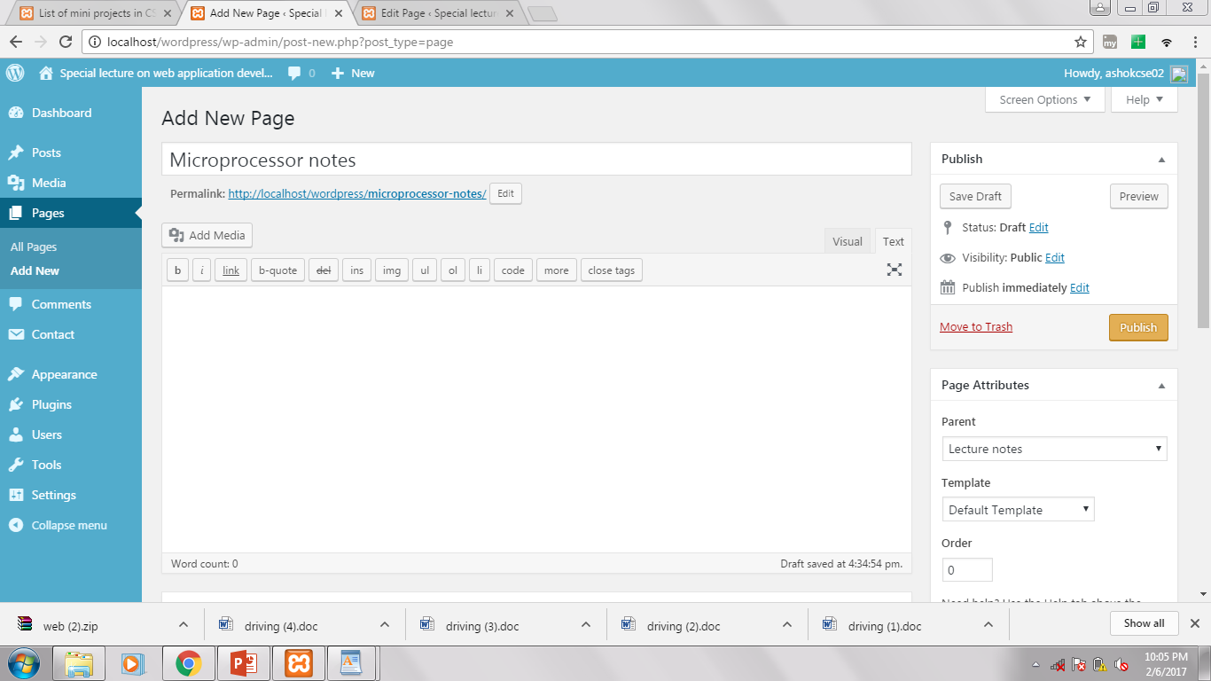

Slide 44
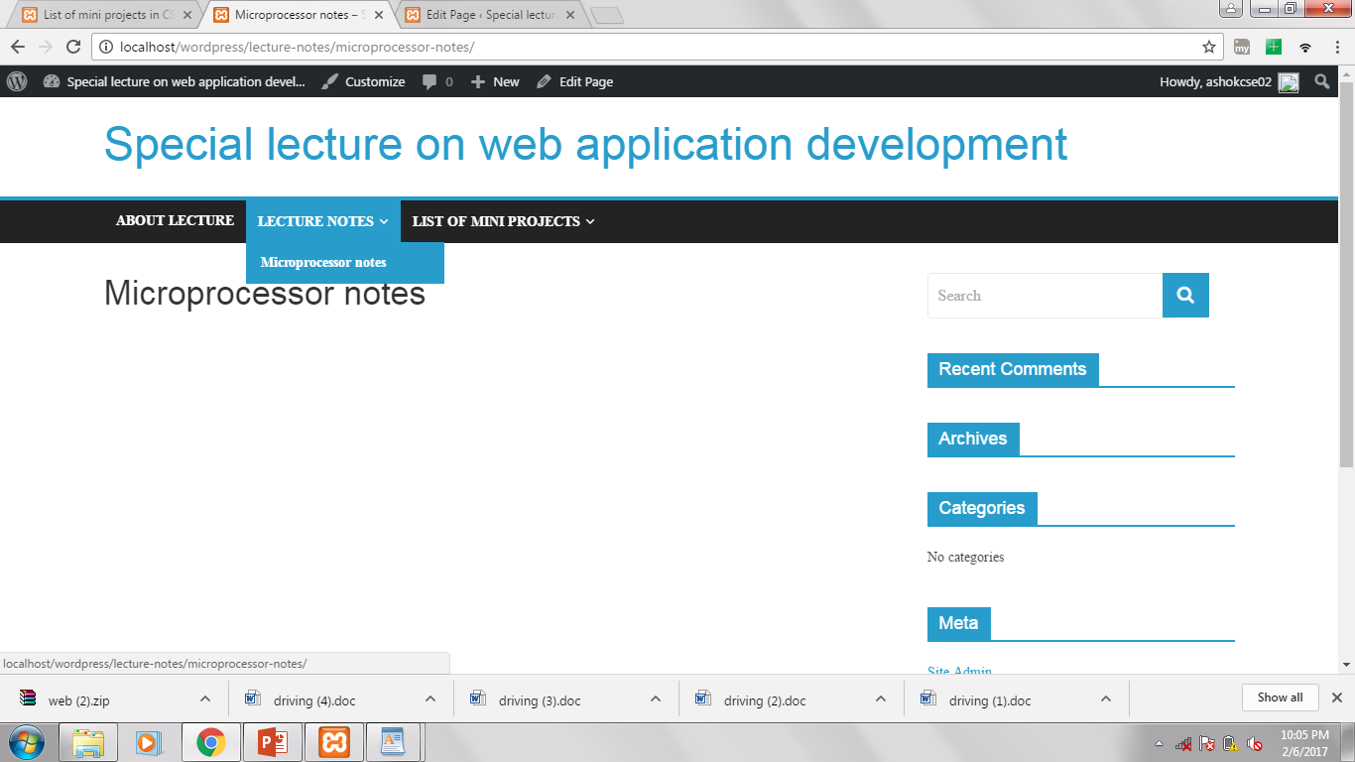

Slide 45
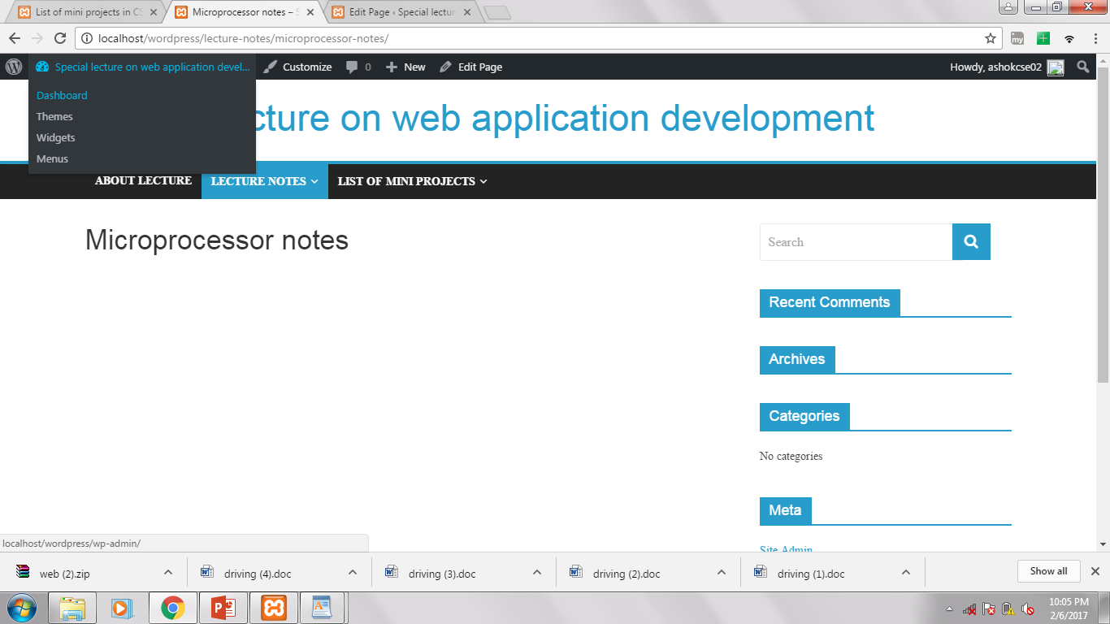

Slide 46
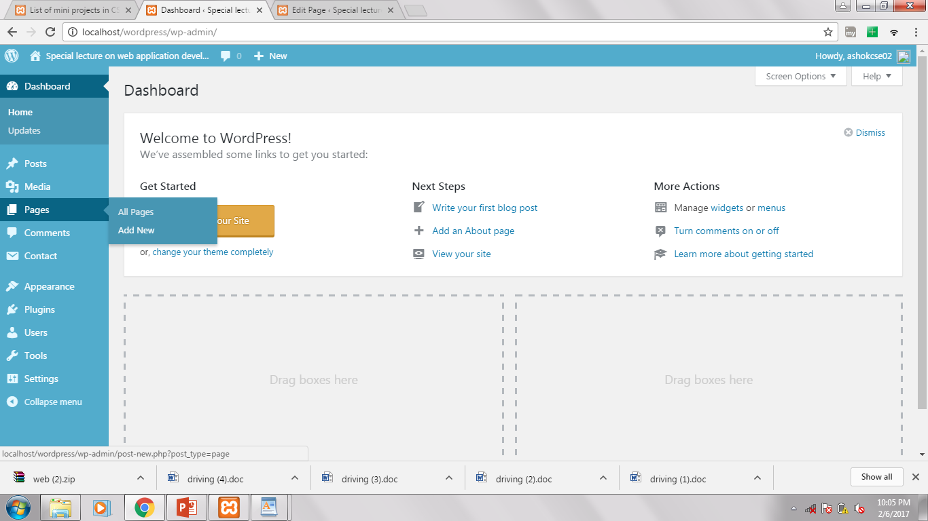

Slide 47
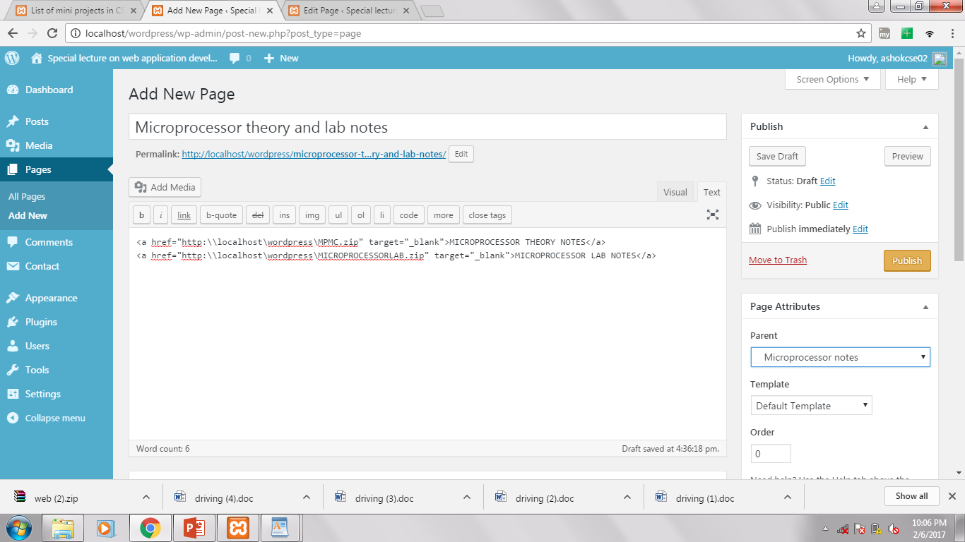

Slide 48
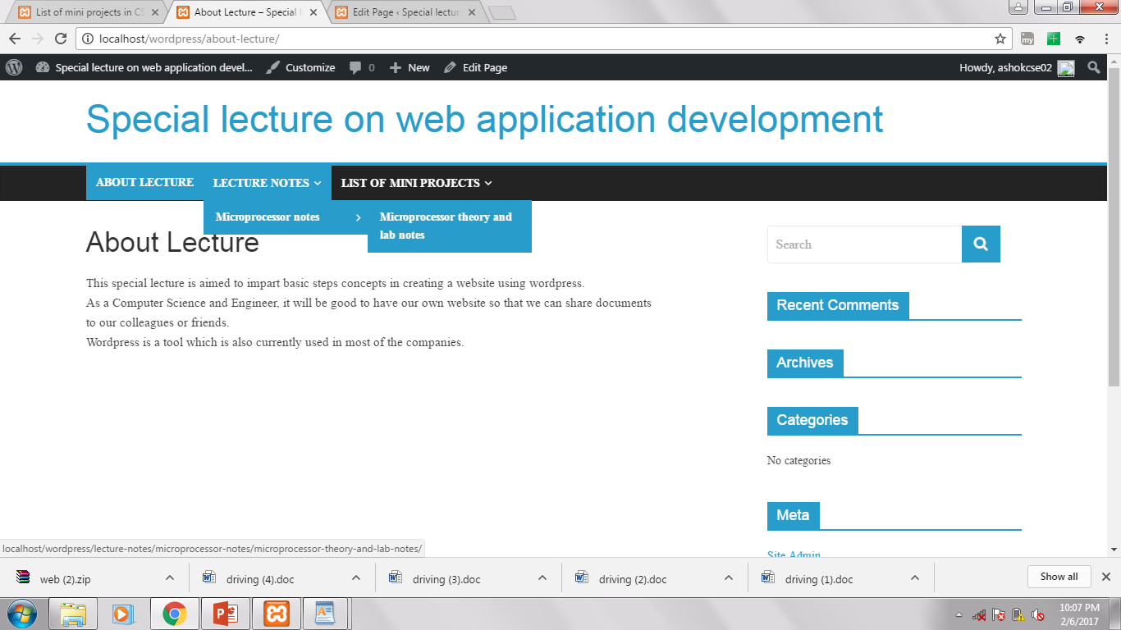

Slide 49
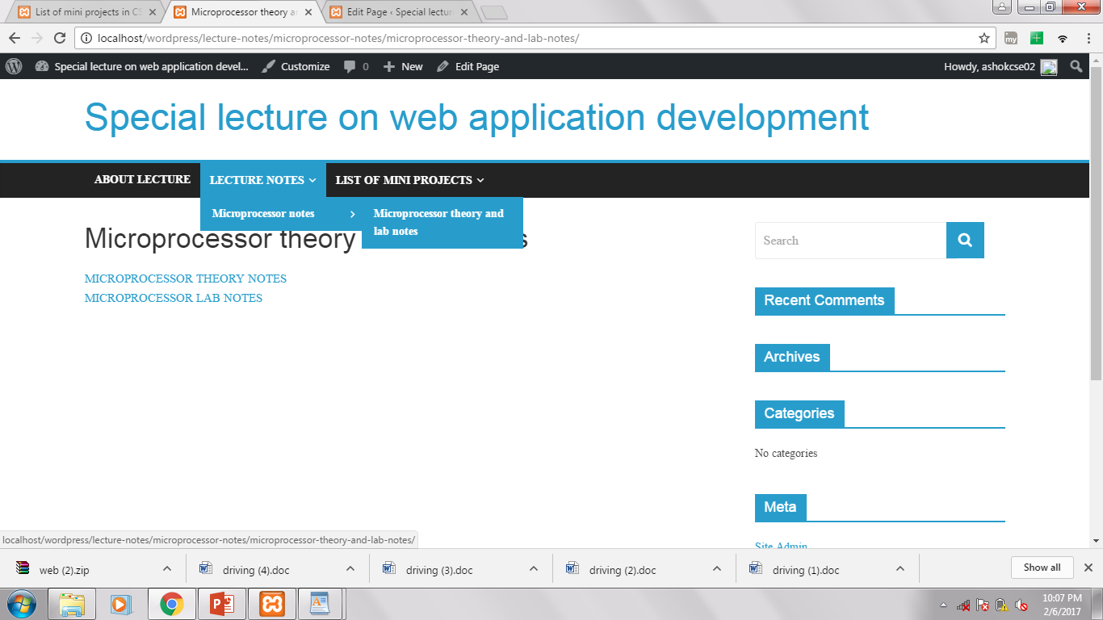

Slide 50
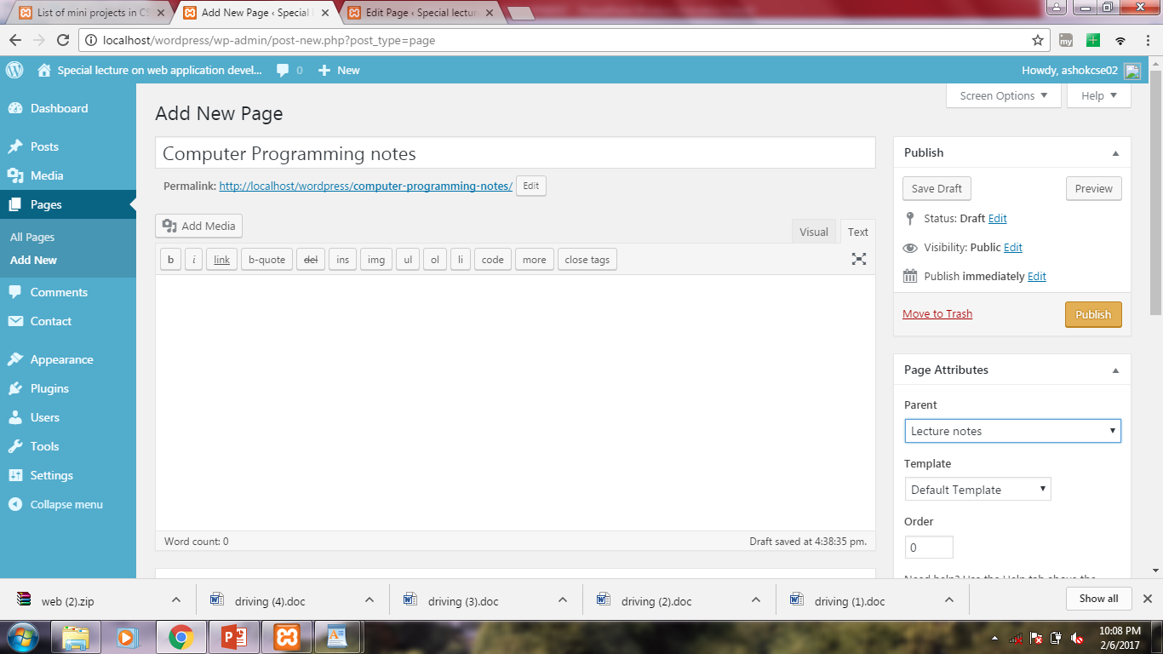

Slide 51
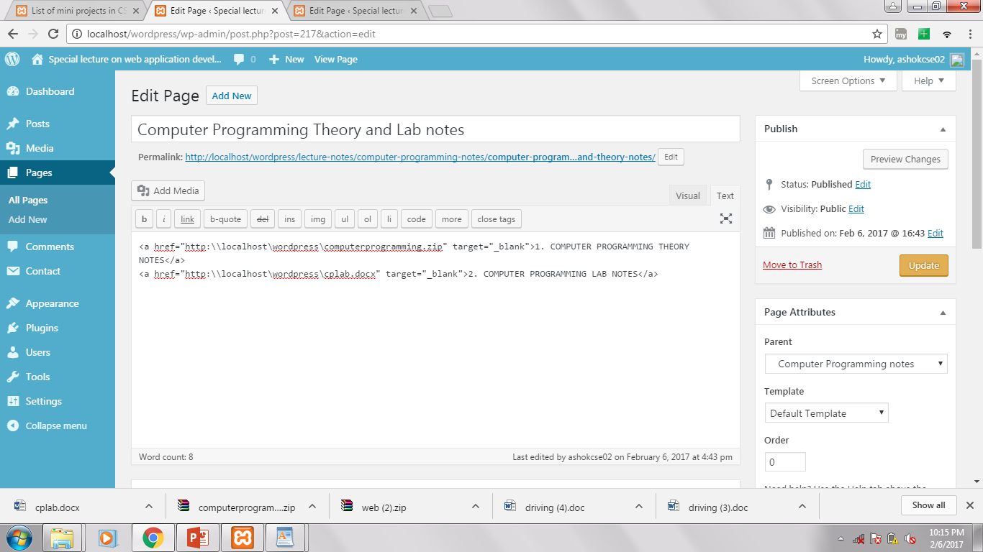

Slide 52
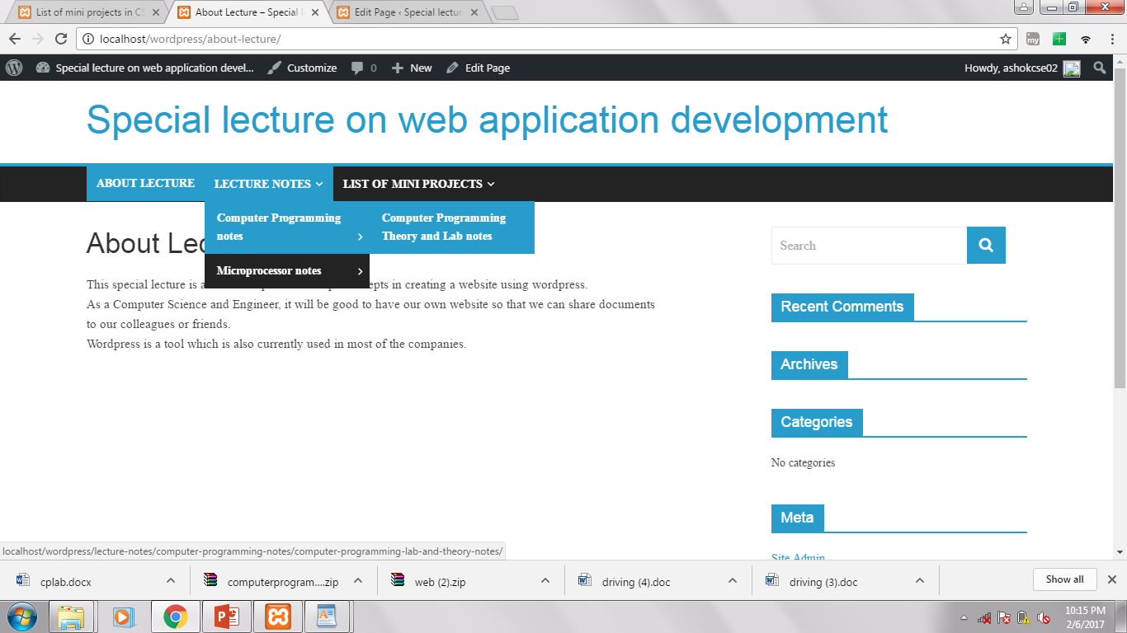

Slide 53
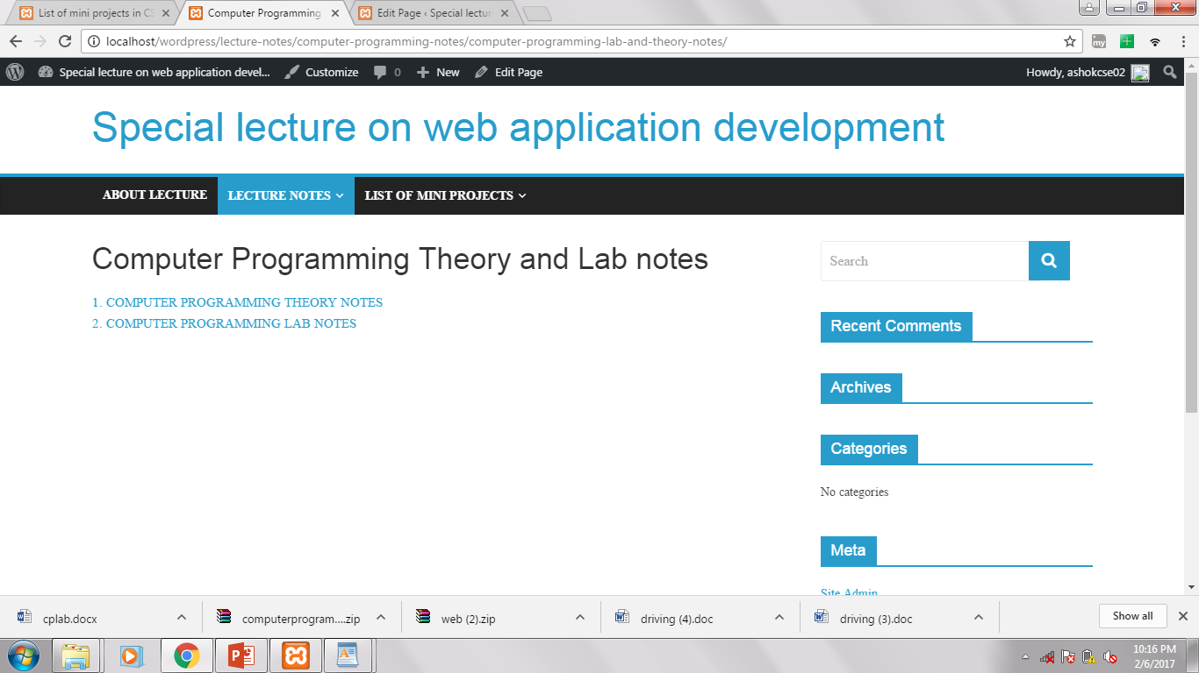

Slide 54
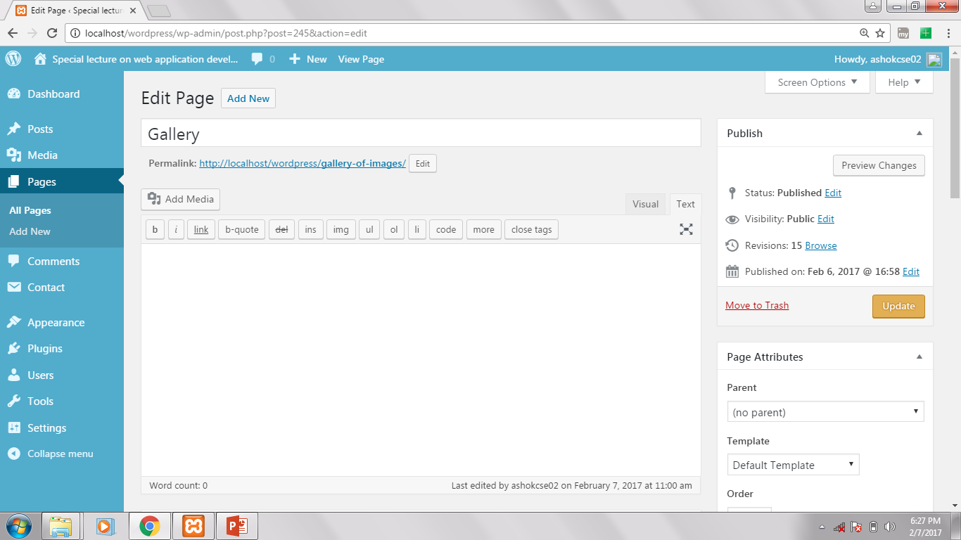

Slide 55
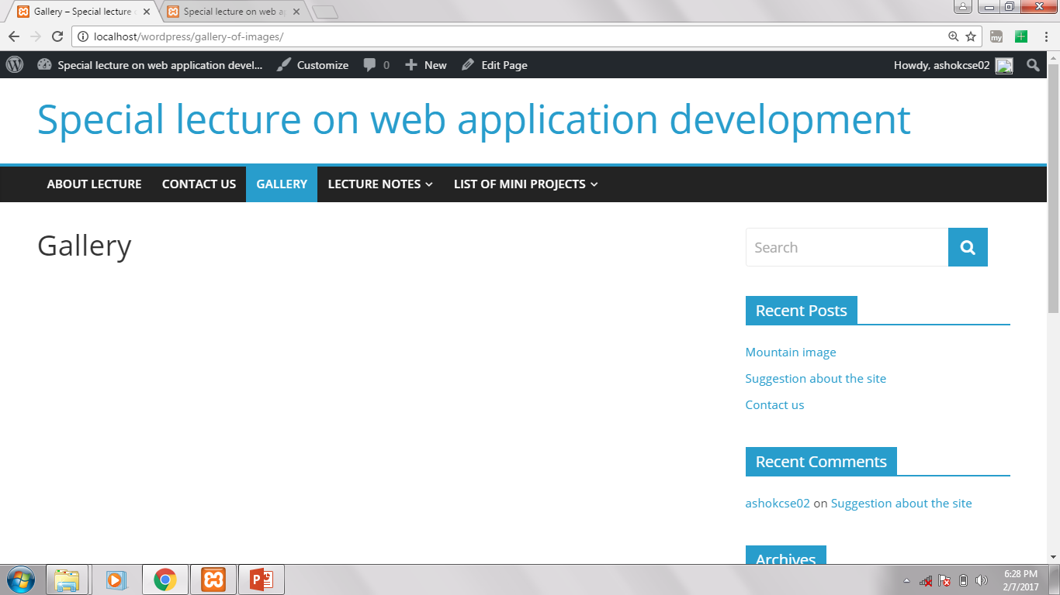

Slide 56
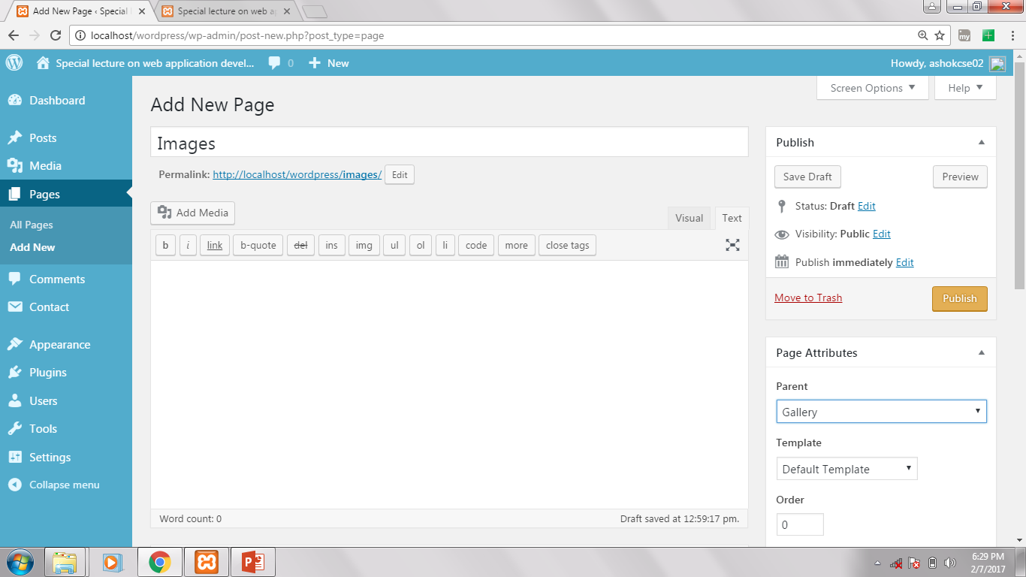

Slide 57


Slide 58


Slide 59


Slide 60


Slide 61


Slide 62


Slide 63


Slide 64


Slide 65


Slide 66


Slide 67


Slide 68


Slide 69


Slide 70


Slide 71


Slide 72


Slide 73


Slide 74


Slide 75


Slide 76


Slide 77


Slide 78


Slide 79


Slide 80
To create contact form
GOTO
Plugins→ Add New → Contact Form 7 → Install→ Activate.
On Left Side We Can see a menu named “Contact” → Add New→ Publish
Copy the short code and Paste in “Contact us” Page which is already created.

Slide 81


Slide 82


Slide 83


Slide 84


Slide 85


Slide 86


Slide 87


Slide 88


Slide 89


Slide 90


Slide 91


Slide 92
Queries???

Slide 93
Thank You !!!

